Slide 1
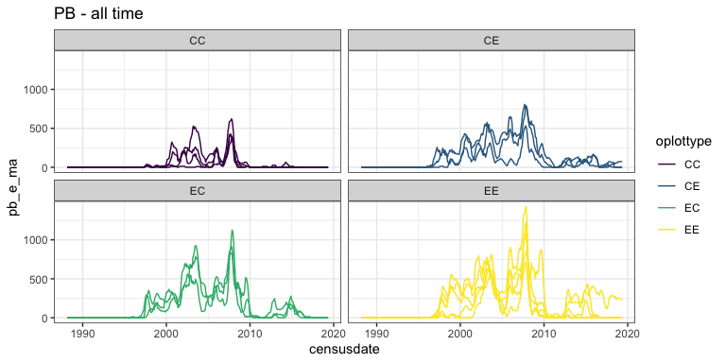
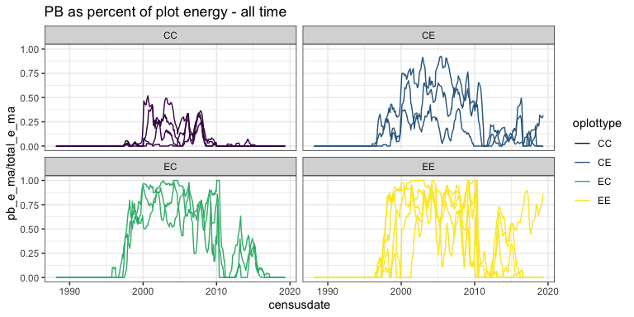
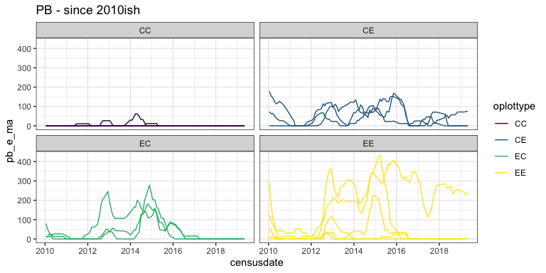
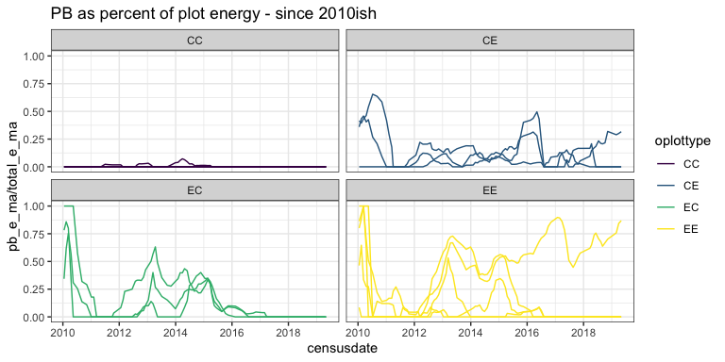
Notes:
- There has been a decline in PB: see a.
- However there has also been a decline in the total energy used on all plots. Such that the decline in PB *as a proportion of the total energy used on the plots* is not as steep as it looks from the raw energy.
- PB has really vacated long term control plots (purple) since about 2010.
- Not so much CE plots. From 2010-2015, PB is still present on those plots. They are controls at that time.
- But following the switch in 2015, PB vacated EC plots. This shows in both the raw and % of plot energy, meaning this isn't just because the total energy increases if you dipo back in.
- There is a single EE plot (I think it's 21) where PB is consistently higher, in both raw and proportional, than the other EE, or the EC, or the CE plots post-2015.
- One could look at this using the pre-switch data, which allows for 8 control and 8 exclosure plots. However, that data ends at 2015. Meaning you won't get the true 0s for CC and EC, and what look like true zeros for some EE plots.

Slide 2
Notes:
- Since 2010 it looks like *less* than in the 2000s, but not *0* (as a % of energy on exclosure plots).

